Slide 1

Presented by
Navya
Team members
Jyothsna
Charan Kumar
Pavan
Jagadeesh Prasad

Slide 2
Comprehensive digital marketing
Topic
Digit Insurance

Slide 3
Part-1: brand study, competitor analysis & buyer’s/ Audience’s persona
Topic : Digit Insurance ( Go Digit General Insurance limited-2016)
Introduction :
Digit insurance is a general insurance company started by Kamesh Goyal in 2016 and backed y the Fairfax Group. Its service include car insurance , travel insurance, home insurance, commercial vehicle insurance, and shop insurance.
Digit insurance is a security provider for all conceivable life instabilities. It provides a range of insurance plans, such as bike insurance, commercial vehicle insurance, auto insurance, health insurance, and travel insurance, among all others. All of these are mode to provide coverage for its clients with the least amount of hassle possible,

Slide 4
Part 1: Brand study, Competitor Analysis & Buyer’s/Audience’s Persona
Research of Brand Identity:
Brand’s Mission:
'To Make Insurance Simple. ' With that as this mission, this is reimagining products, and redesigning processes. This is going back to the basics and building simple and transparent insurance solutions, that matter to people. Brand’s Values: Digit Insurance has raised $478.85M over 10 rounds. Digit Insurance's latest funding round was a Unattributed for on April 24, 2023. Digit Insurance's valuation in May 2022 was $4,000M. Digit Insurance's latest post-money valuation is from May 2022.
Brand’s Vision: this organization believes this can be changed; the way insurance products are viewed, purchased, and claimed. Simply put, this is here 'To Make Insurance Simple. ' With that as brand mission, this is reimagining products, and redesigning processes
Brand’s Unique Selling Propositions (USPs): A unique selling point (USP), also called a unique selling proposition. The Digit Insurance business model works just like the business models that the insurance companies opt for, the only difference is that Digit aims to introduce a range of new products and services to disrupt the Indian general insurance sector.

Slide 5
ANALYZE OF BRAND MESSAGING:
A brand strategy is plan for how a company will create, delivery, and market its products or services. It’s vital part of a company’s overall business strategy.
the product strategy of digit insurance is to provide affordable simple, and convenient insurance products that meet the needs of our customers
EXAMINE THE BRAND TAGLINE
Digit Insurance tagline is “keeping it Simpler” – Go Digit General Insurance Limited mainly focuses on making the overall process of insurance much simpler to all the India people and this is their prime motto indeed

Slide 6
Competitor analysis:
Acko:
The main rival of Digit Insurance is Acko. It was established in 2016 in Mumbai. It also functions in the insurance sector,
Cover fox:
One of the Digit Insurance’s biggest rivals is Cover fox. It was established in 2013 and has its headquarters in Maharashtra, India’s Andheri East Additionally, it works in the insurance industry.
Policy Bazaar:
Another fierce competitor of Digit Insurance is Policy Bazaar. Its corporate headquarters are in Gurgaon, Haryana. It was established in 2008. The business is a competitor in the insurance industry.

Slide 7
Buyer’s/ audience persona
Digit insurance is a security provider for all conceivable life instabilities. It provides a range of insurance plans, such as bike insurance, commercial vehicle insurance, auto insurance, health insurance, and travel insurance, among all others. All of these are mode to provide coverage for its clients with the least amount of hassle possible,
Demographic factors : this company is giving priority towards audience according to demographic factors like age, race, gender, family size, income or education in insurance policies.
Psychographic factors: Company gives importance to psychographic factors like personality traits, attitudes, interest, values and other lifestyles in insurance policies.
Behavioural factors: company works on customers online behaviour in near real time and encompasses search data like keyword usage providing a better view of measurable actions and needs,

Slide 8

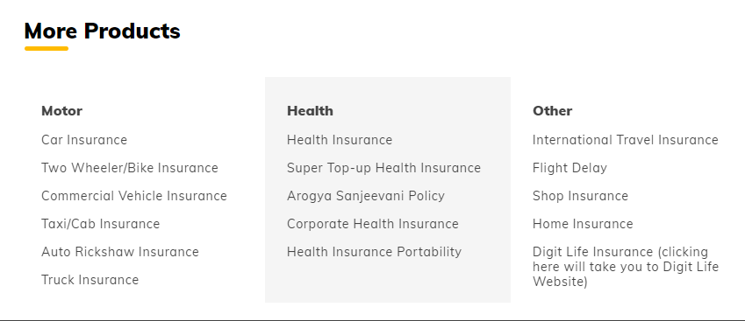
Part-2: SEO & keyword Research
SEO Audit of Digit Insurance website:

Slide 9
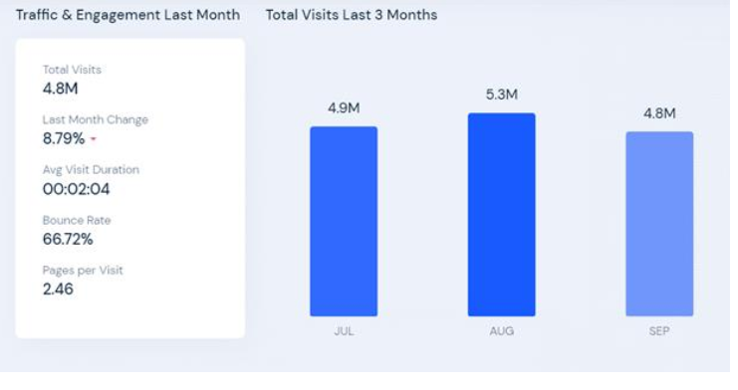

Slide 10
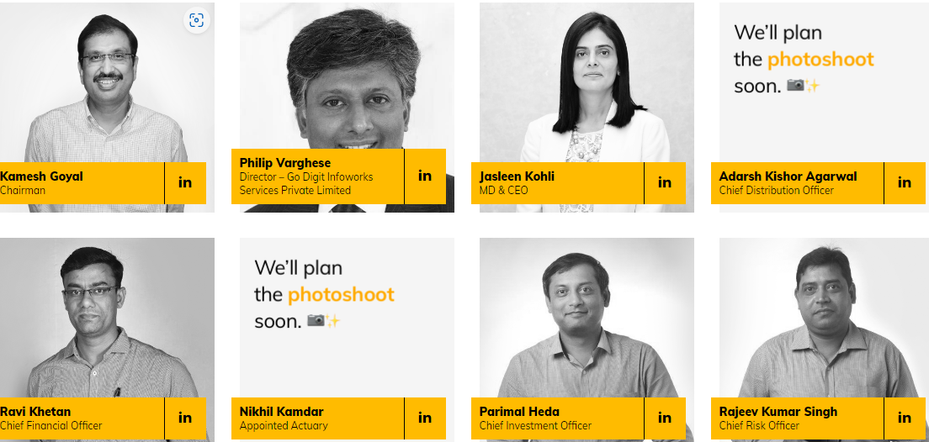
Board of Directors

Slide 11
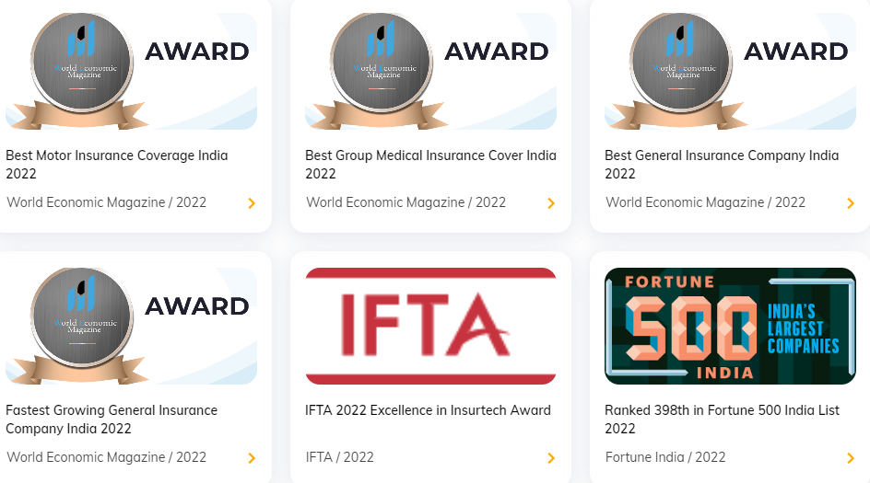
awards

Slide 12
Keyword Research
Digit Insurance Research Objectives:
Company is an initiative by Startup Talky to publish verified information on different startups and organization. The content in this post has been approved by Digit Insurance.
Life is risky and uncertain. We don’t know what is waiting for us. One may face an untimely death or lose a climb anytime. Accident do not appear after knocking on your front door, we just meet with it unexpectedly.
Digit insurance is a security provider for all the insecurities that may occur in one’s life.

Slide 13
Brainstorm seed keywords: Seed keywords are words or phrases that you can use as the starting point in a keyword research process to unlock more keywords. Think of them as the building blocks o keywords research.
Keyword Research Tools:

Slide 14
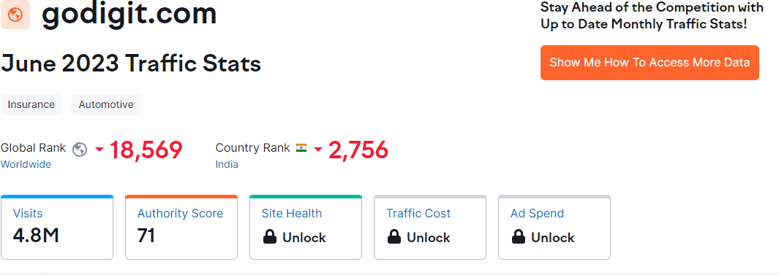
Keyword Research Tools:
SEMRUSH
SEMrush is a popular SEO tool for conducting keyword research, comperitor analysis, and Google Ad optimization. It is an all in one marketing reporting software designed to help digital marketers optimize their websites for better organic search traffic.

Slide 15
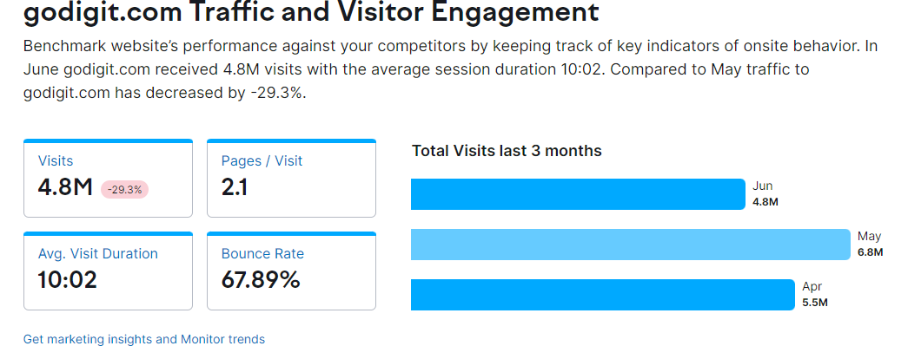

Slide 16
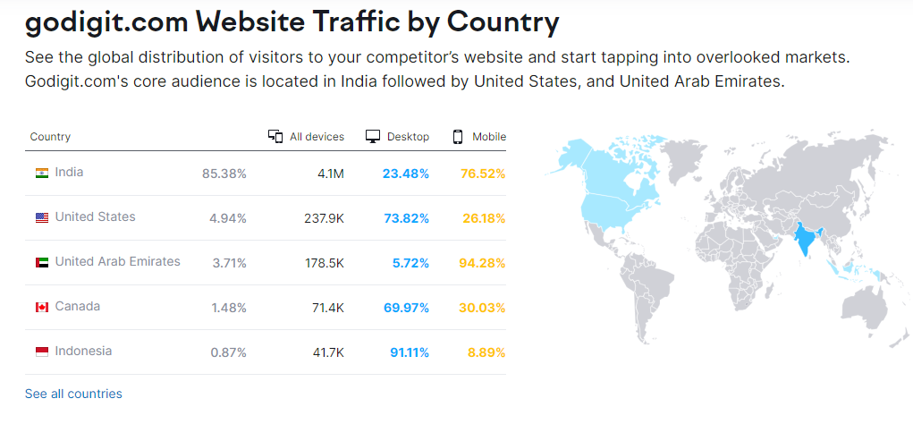

Slide 17
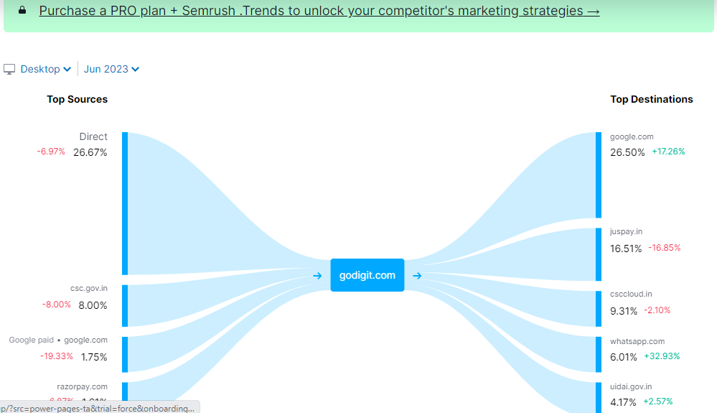

Slide 18
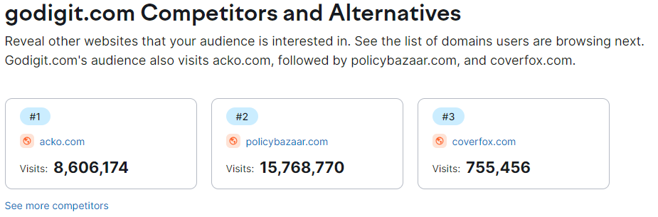

Slide 19
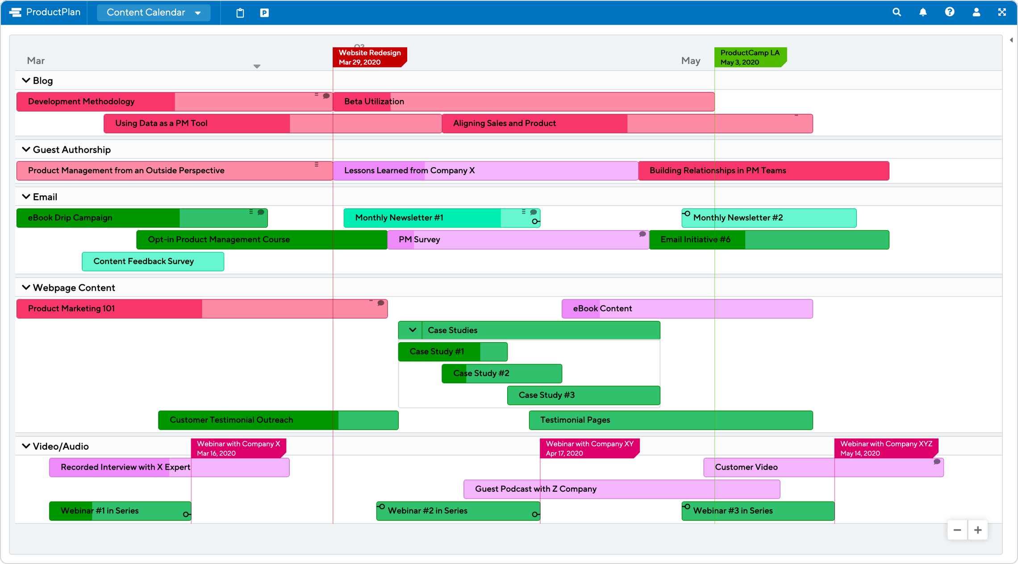
PART-3 CONTENT IDEAS AND MARKETING STRATEGY
Content Idea Generation &Strategy:

Slide 20
Strategy, Aim and the Idea behind these posts and stories
Ensures consistency: Content calendar lays out all your marketing activities including past, present and future, so you can better see how each activity relates to the others. This feature allows you to plan a more consistent schedule of activities – and make sure that they all work together to build your brand.
A content calendar is a resource to plan, schedule, and organize content creation and publishing. Marketing teams rely on their content calendars to plan campaigns across different platforms—like the company's blog, email marketing, and social networks.
A content calendar is important to keep your content marketing well-organized and on track. It helps you with initial brainstorming, which saves you from last-minute disastrous planning and helps you produce content consistently.
A social media calendar lets you plan, batch your work, avoid multitasking, and note down all your content ideas for later. Social media planning calendar tools even allow you to schedule social media posts ahead of time

Slide 21
Content, Ideas & Marketing strategies process
Adopt a unique angle with your content. Know Your Audience.
Tap into current trends.
Build evergreen content.
Nurture your email subscribers.
Create original research.
Write your case studies.
Build Interactive Tools.

Slide 22
Testimonials and Reviews.
Repurpose content.
Update old content.
Encourage user-generated content.
Guest Blogging.
Create videos on social media.
Host a podcast.
Offer lead magnets in exchange for email

Slide 23
Challenges encountered and lessons learned in marketing strategies
Recruiting talent.
Maintaining a sufficient budget.
Generating leads. ...
Finding the right tools.
Being risk-averse.
Moving into new markets.
Retaining customers.
Retaining and training staff.
Choosing effective tactics.
Facing increased competition.

Slide 24
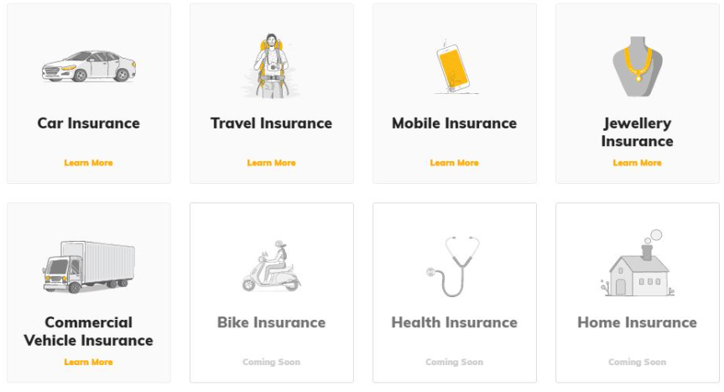
Part 4: Content Creation and Curation
Format 1-

Slide 25
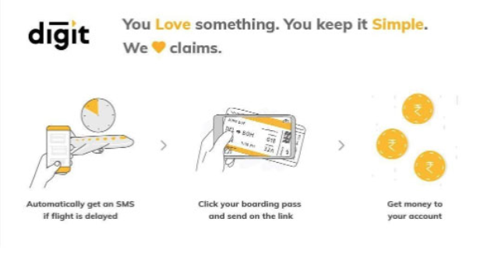
Format -2

Slide 26

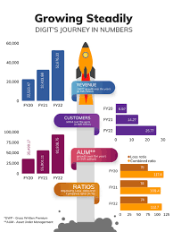
Format-3

Slide 27

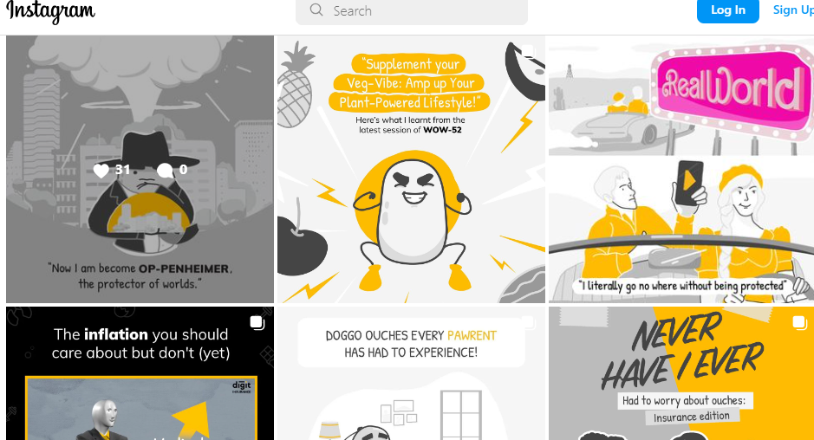
Instagram Story

Slide 28
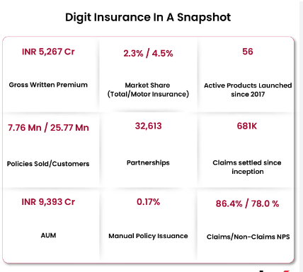
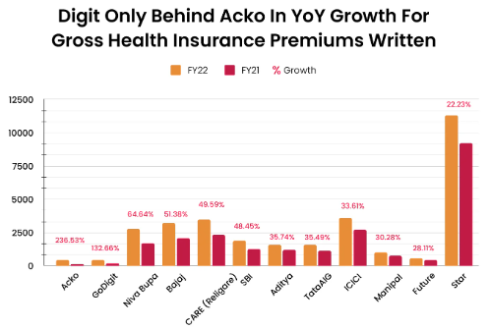
Insight Tool Analyse

Slide 29
Strategies and Areas for Improvement
Redefine your marketing strategy as per your goals.
Create/hire your digital marketing team.
Focus on SML.
Create multi-channel campaigns.
Develop an exceptional content creation strategy.
Optimize the content.
Rely on automation.
Continuous improvement is the key.

Slide 30
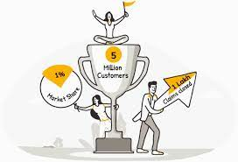
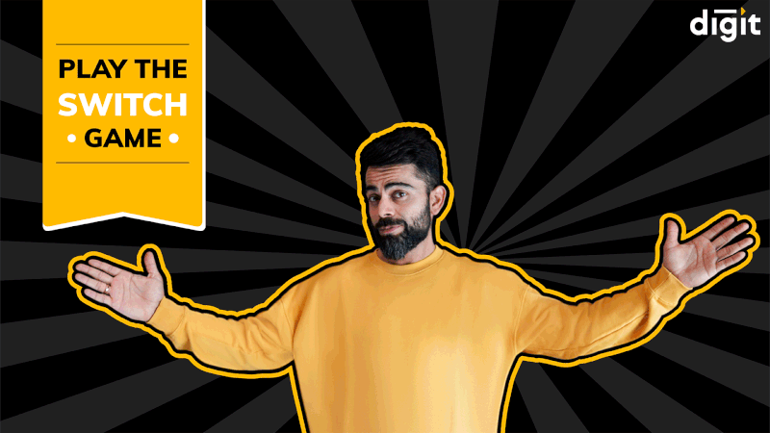
Designs/Video Editing
Tools formation

Slide 31


Designs/Video Editing
Video making
Video making

Slide 32
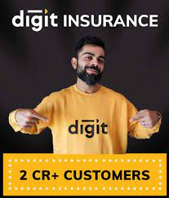

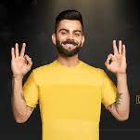
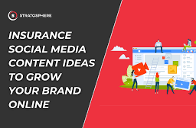
Social Media Ad Campaign

Slide 33
Advertising Goals. Brand Awareness: Brand awareness refers to the level of familiarity consumers have with a particular brand. It is measured by how well consumers can recognize the brand's logo, name, products, and other assets. Driving website traffic: Website traffic refers to the volume of users visiting a website. How many people visit a website will depend on the website's purpose, the visitors' own goals, and the way in which they discovered the site. Generating leads: Lead generation is the process of generating consumer interest for a product or service with the goal of turning that interest into a sale. In online marketing this typically involves collecting a visitor's contact information (called a “lead”) via a web form.

Slide 34
Audience Targeting: Your target audience refers to the specific group of consumers most likely to want your product or service, and therefore, the group of people who should see your ad campaigns. Target audience may be dictated by age, gender, income, location, interests or a myriad of other factors. Target demographics include information about your audience's age, gender, income, geo-location, religion, ethnicity, education, family size, and other measurable and observable characteristics. Analyze users by age, gender, and interest categories. Demographics and interests data provides information about the age and gender of your users, along with the interests they express through their online travel and purchasing activities.

Slide 35
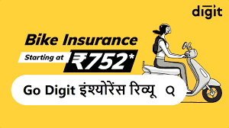
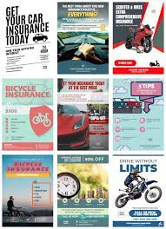
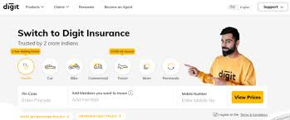
Ad creation of Digit insurance

Slide 36
Email Ad Campaign
1. Brand Awareness Understanding your target audience is the first step to building a successful email marketing campaign that builds brand awareness. It means taking the time to identify who your ideal customer is, what their interests are, and what they're looking for in a product or service. 2. Generation lead Email lead generation involves gathering potential customer information via an opt-in form that typically requests a name and email address. This helps build an email list for future marketing campaigns, allowing businesses to target interested individuals and nurture them through the sales funnel.

Slide 37
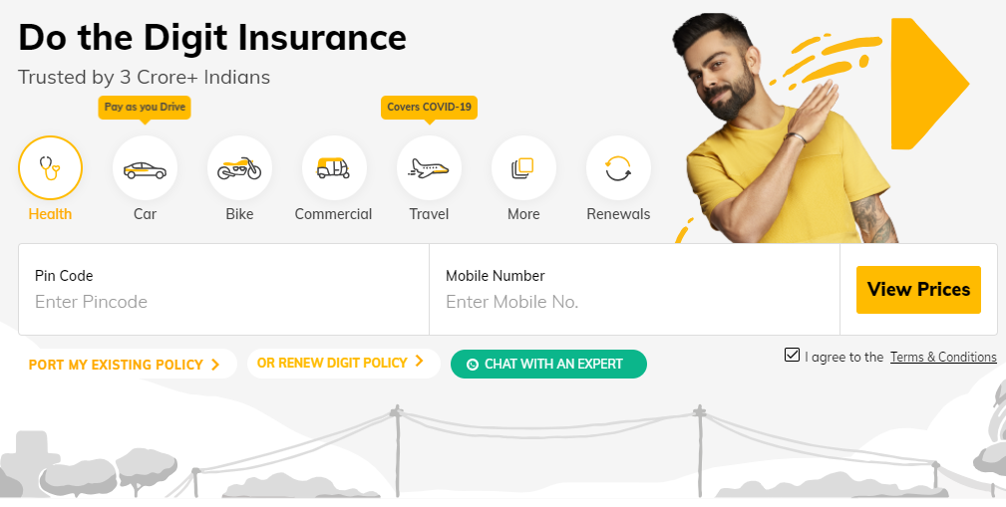
Email Ad Campaign -1
Brand Awareness

Slide 38
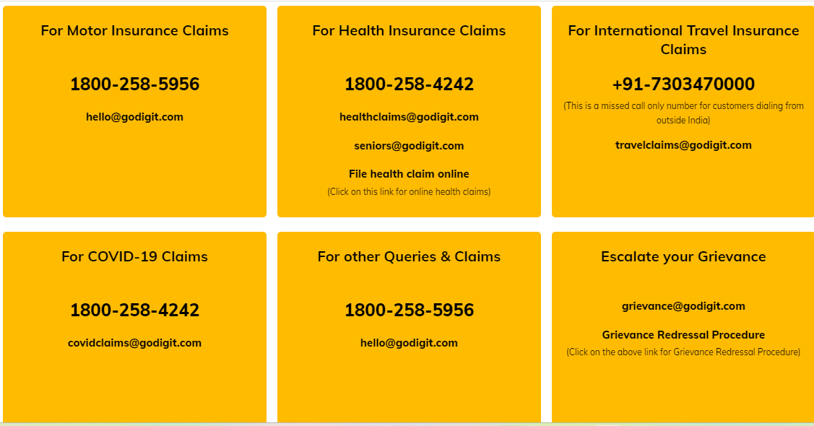
Email Ad Campaign -2
Lead Generation

Slide 39
Content Creation and Curation Process Essentially, content curation relates to finding, filtering, and sharing relevant content created by others with your audience. On the other hand, content creation is what it sounds like – creating new content for your audience.
Challenges faced and lessons learned:
Producing high-quality content.
Generating content consistently.
Prioritising content expertise.
Understanding different buyer personas.
Producing content in suitable formats.
Measuring content ROI.
Creating buy-in among stakeholders.

Slide 40
Thank you

